Slide 1
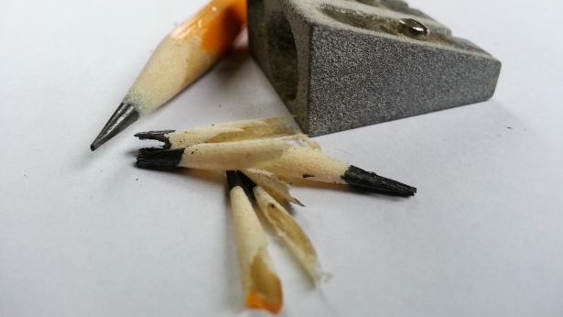
Sharpen Your C# Skills
Sean Sparkman

Slide 2
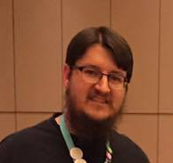
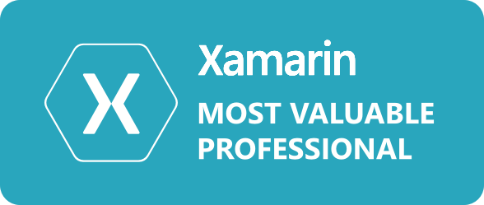

Sean Sparkman
Father, Husband, President of DFW Mobile .NET User Group, Xamarin MVP, and Team Lead and Senior Developer at @IInteractive
Email: sean.sparkman@iinteractive.com
Twitter: @seansparkman

Slide 3
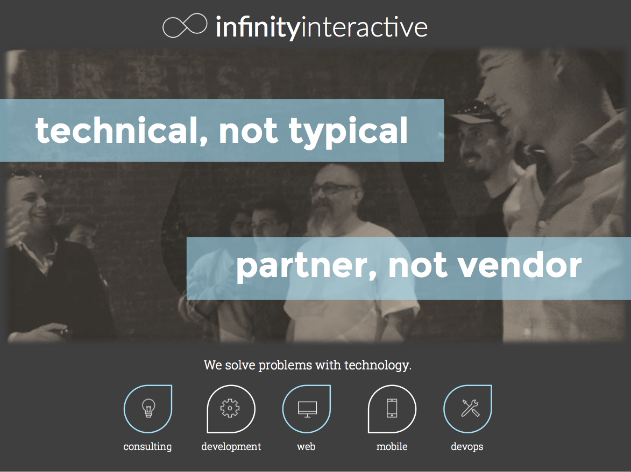

Slide 4

http://www.dfwmobile.net
@DFWMobileNet

Slide 5
Xamarin Dev Days Dallas
April 15 – 9 AM
7100 State Highway 161, Irving
bit.ly/XamarinDevDays

Slide 6

C#
Microsoft as part of its .NET initiative and is now a multi-paradigm standardized modernized language. Since its inception, C# has added over 50 features and continues to add more.

Slide 7
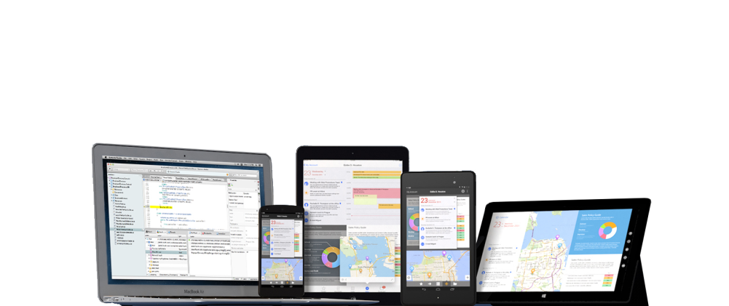
C# runs on 2.6 Billion Devices

Slide 8

C#
Object-Oriented
General Purpose
Modern
Still be developed
Current Version 7.0
Released March 7, 2017

Slide 9
Version 2.0
Generics
Partial Types
Anonymous Methods
Iterators
Nullable Types
Getter/Setter Separate Accessibility
Method group conversions (delegates)
Co- and Contra-variances for delegates
Static Classes
Delegate inferences

Slide 10
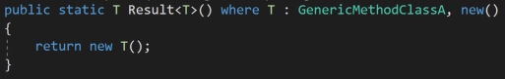
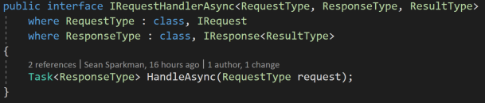
Generics
Allow typing of classes and methods
Remove the need for casting
More efficient

Slide 11
Partial Types
Allows you to split classes over multiple files
Separate generated code from user code
Examples:
Web Forms Code Behind
XAML Code Behind
MVC OWIN Startup Classes

Slide 12
Anonymous Methods
Before 2.0, the only way to use delegates was named functions
Later supersede by Lambda Expressions in 3.0
Can omit the parameter list unlike Lambda Expressions

Slide 13
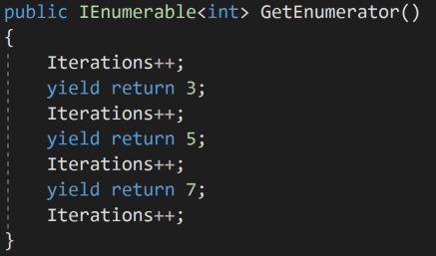
Iterators
Better known for foreach keyword
yield keyword is the better part of this improvement
Remembers where you last left off

Slide 14
Nullable Types
Allows value types to be null
Useful with optional parameters and the default value is valid (i.e. 0)

Slide 15
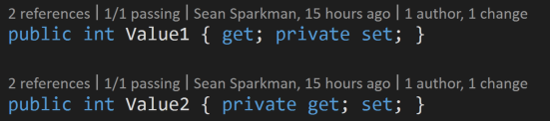
Getter/Setter Separate Accessibility
Allows for private or protected setters or getters when the other is public
Useful immutable

Slide 16
Method Group Conversions (delegates)
Made code simpler
Pre-lambda
Just pass the method instead of a delegate
Notes:
http://www.ginktage.com/2011/03/using-implicit-method-group-conversion-in-c/

Slide 17
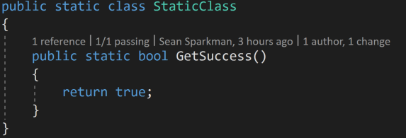
Static Classes
Cannot be initialized
Great for Utility Classes

Slide 18
Version 3.0
Implicitly typed local variables
Object and collection initializers
Auto-Implemented properties
Anonymous Types
Extension Methods
Query Expressions
Lambda Expressions
Expression Trees
Partial Methods

Slide 19
Implicitly typed local variables
Use of “var”
var keyword does not mean variant
Notes:
https://msdn.microsoft.com/en-us/library/bb384061.aspx

Slide 20
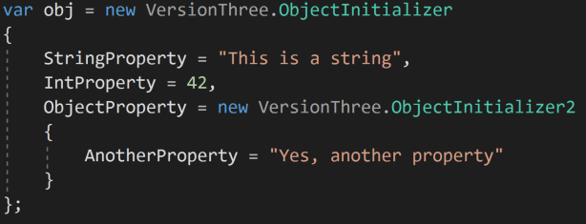
Object and collection initializers
Makes code easier to read
Developer does not have to write add repeatedly
Notes:
https://msdn.microsoft.com/en-us/library/bb384062.aspx

Slide 21
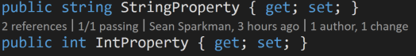
Auto-Implemented properties
Makes code easier to read and faster to write
Developer does not have to implement backing field

Slide 22
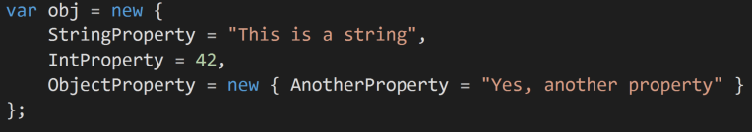
Anonymous Types
Read-only
Quick and dirty objects without writing POCO’s

Slide 23
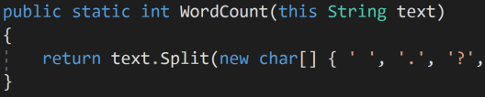
Extension Methods
Allows developer to add methods to existing classes
Only requires inclusion of namespace to bring into projects

Slide 24
Query Expressions
LINQ

Slide 25
Lambda Expressions
Anonymous function used to create delegates and tree expressions

Slide 26
Expression Trees
Used for LINQ
Data structure that represents code

Slide 27
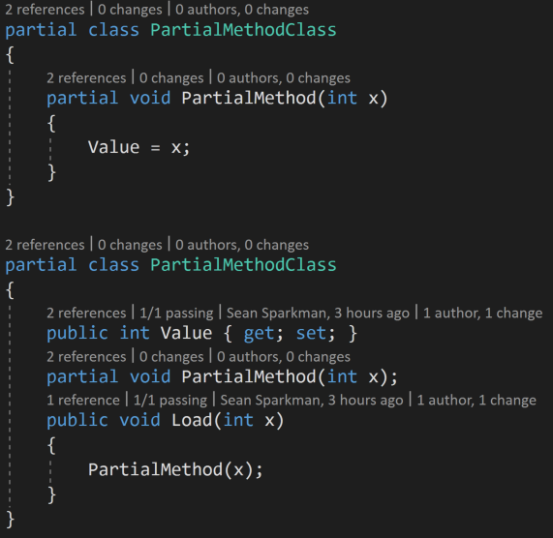
Partial Methods
Signatures must match
Must return void
Implicitly private, no accessor modifiers

Slide 28
Version 4.0
Dynamic Binding
Named and optional parameters
Generic co- and contravariance
Embedded Interop types (“NoPIA”)

Slide 29
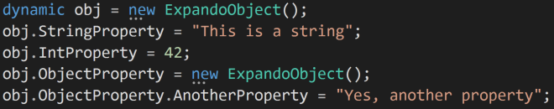
Dynamic Binding
Allows C# to act like loosely-typed language
Properties and methods do not have to be defined at compile time
Example: ViewBag from MVC

Slide 30
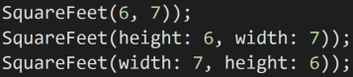
Named and optional parameters
No longer do you have to override methods for multiple signatures

Slide 31
Version 5.0
Asynchronous Methods
Caller Info Attribute

Slide 32
Asynchronous Methods
A whole other talk
async/await

Slide 33
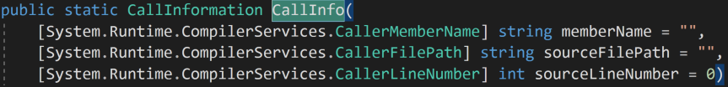
Caller Info Attribute
Allows you see information on the source code

Slide 34
Version 6.0
Compiler-as-a-service
Import of static type members into namespace
Exception Filters
Await in catch/finally blocks
Auto property initializers
Expression-bodied members
Null propagator (null-conditional operator, succinct null checking)
String Interpolation
nameof operator
Dictionary Initializer

Slide 35
Compiler as a Service
Roslyn API
Whole other talk

Slide 36
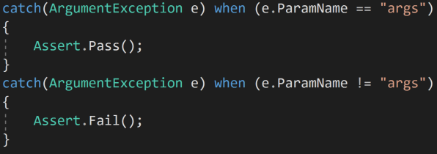
Exception Filters
Allows catching of the same exception to different code blocks
Requires conditional statement
Organizes code instead of having if statements in catch blocks

Slide 37
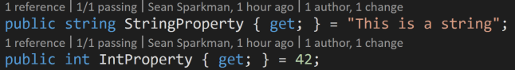
Auto property initializers
Allows developer to set defaults for get only properties
Allows developer to set defaults for properties without a constructor

Slide 38
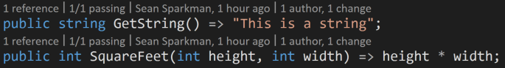
Expression-bodied members
Expressions, Expressions EVERYWHERE!
If you didn’t like curly brackets, you’ll love this…
There is more in 7.0...

Slide 39
Null propagator
?. Operator
No more null reference exception!
Well, maybe…
Compiler warnings for use of . operator

Slide 40
String Interpolation
Finally
No more needed string.Format

Slide 41
nameof operator
Returns the name of your property
Great for MVVM

Slide 42
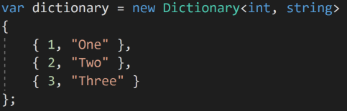
Dictionary Initializer
Makes for more organized dictionary creation
No more messy dictionary code!

Slide 43
Version 7.0
Binary Literals
Digit Separators
Local Functions
Type switch
Ref Returns
Named tuples
Out var
Arbitrary async returns
Expression bodied getters and setters
Expression bodied constructors and finalizers

Slide 44
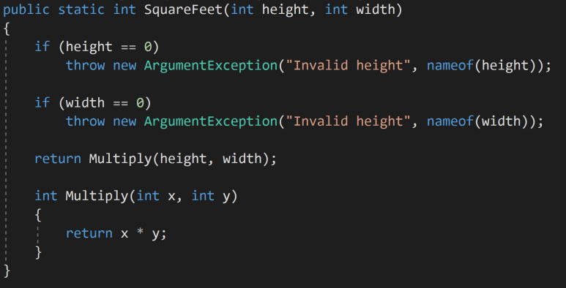
Local Functions
Organized Functions
Functions inside of Functions

Slide 45
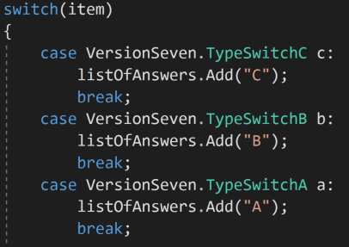
Type switch
Great for inheritance of interface
Reduces the complexity of code by removing excessive if else if’ing

Slide 46
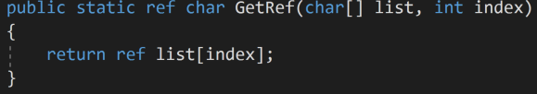
Ref Returns
Similar to pointers

Slide 47
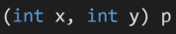
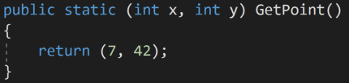
Named tuples
Reduces the need of POCO’s for simple classes or structs
No more Item1, Item2, Item2, etc.

Slide 48
Out var
Removes extra line for variable declaration

Slide 49
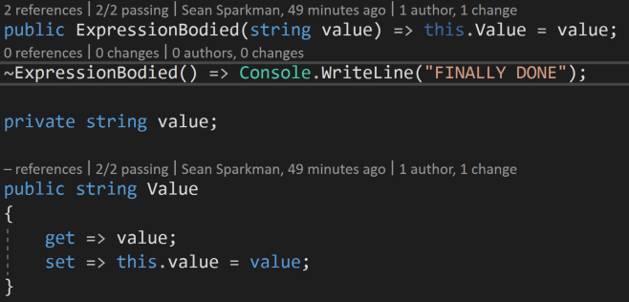
Expression bodied… EVERYTHING!
Expression bodied getters and setters
Expression bodied constructors and finalizers
Even less curly brackets!

Slide 50
Future Versions
Pattern Matching
Records
With expressions
Non-null Reference Types
Async Main
Address of Static
Bestest Betterness
private protrected
Source Generation

Slide 51
Thank You! Questions?
Sean Sparkman
Xamarin MVP / Team Lead / Senior Programmer
sean.sparkman@gmail.com
@seansparkman

